Slide 1

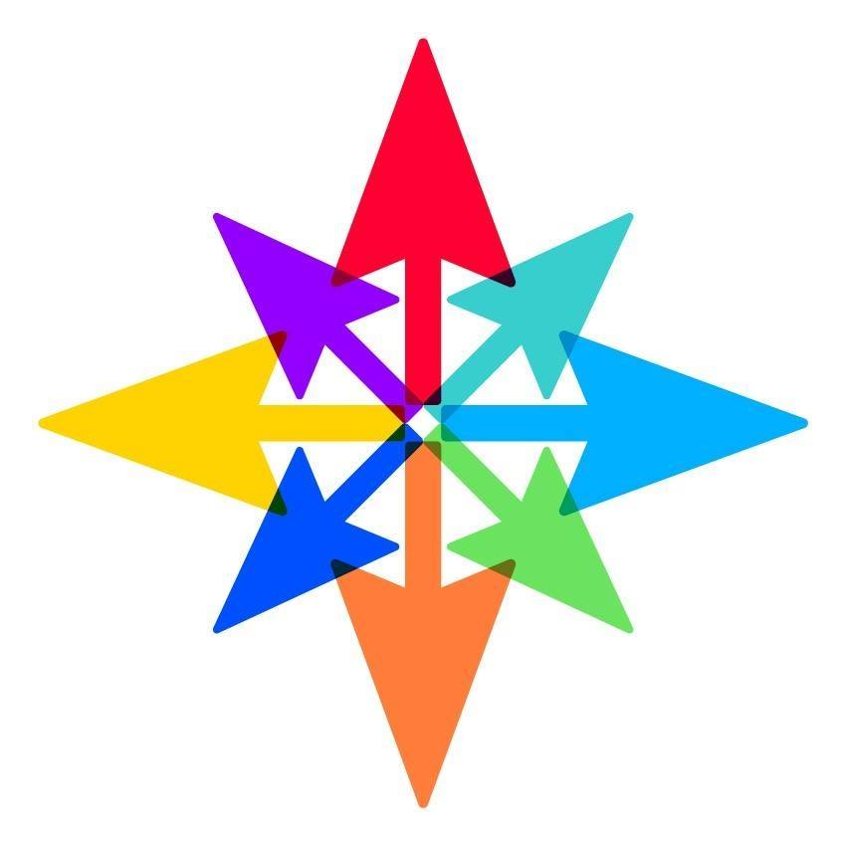
TOGETHER FOR SHORT LIVES
SEARCH STAR
GOOGLE GRANTS WEBINAR

Slide 2
Hello!
SearchStar – Bath based media agency
Run a number of charity accounts: WWT, National Aids Trust, MS Trust, Mare & Foal
jo@search-star.co.uk
Feel free to contact for any help/mini audits

Slide 3
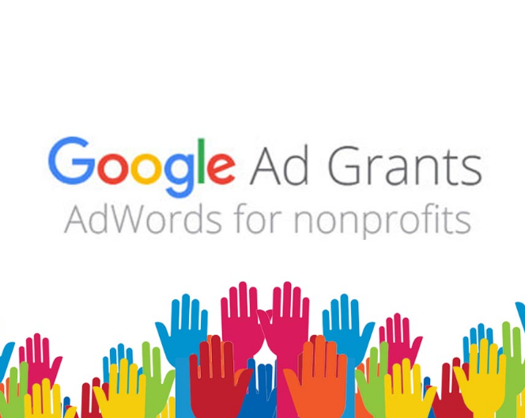
What is Google Grants?
In-kind advertising of up to $10,000 p/m from Google Ads
Only for non-profits
Ads are entirely text-based, and only on Google Search
Ad positions will be below the ads of paying advertisers
Can’t be used to “sell”

Slide 4
The Essentials

Slide 5
New Criteria
On 1st January 2018, made changes to the grants system
Changes were beneficial, but came with some caveats
  No more $2 bid cap
  Maintain a 5% account level CTR
  Must make use of geo-targeting
  Two active ad groups, with two active ads
  At least two sitelink extensions
  Changes to keywords
  Regular changes (something every 3 months)
Tip: Avoid AdWords Express, you will do more good simply structuring the account in a way that makes sense
Relevant keywords
Quality score
Best practice Ads
CTR
Conversions

Slide 6
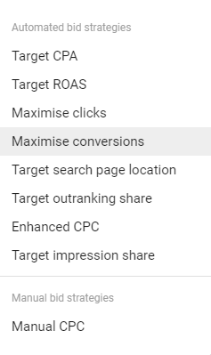
$2 Max Bid Or Not?
It’s always been notoriously difficult to spend the $10,000 due to the $2 bid cap…this is no more
$2 max bid lifted for conversion-based bidding strategies

Slide 7
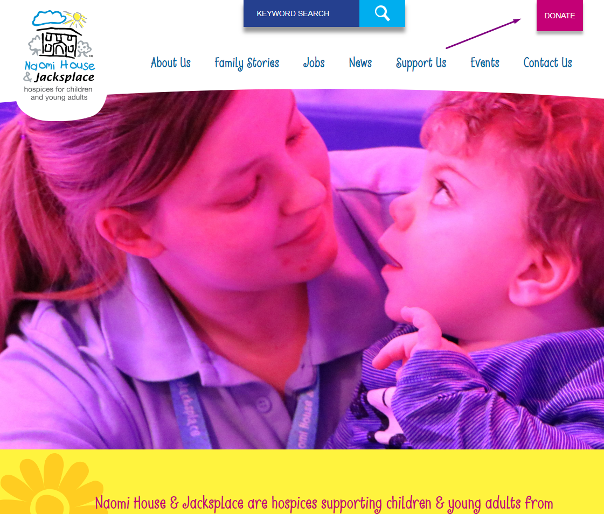
Conversion Tracking
Reflects website goals, so donations, purchases, membership fees, signups
Goal can’t just be a visit to your homepage, but could be something like page per session
Two options:
  Hard code the Google Ads tag onto the site on to conversion pages
  Setting up a goal in Google Analytics and linking the two (preferred)
Using this will allow you to optimise towards those conversions, with the system changing bids (above $2) if it thinks it’ll achieve your goal

Slide 8
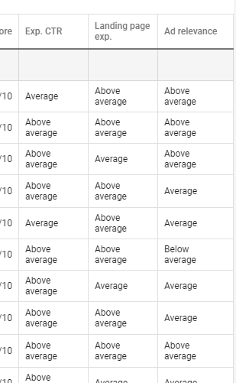
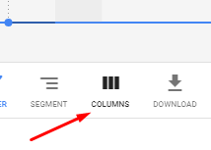
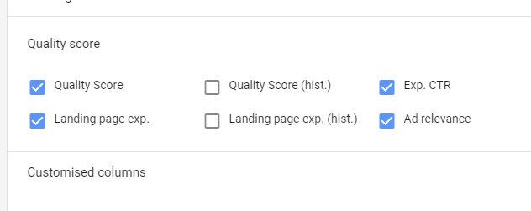
Quality Score
Quality score is at the centre of all good account structures
Score from 1-10
Scores for grant accounts must be a minimum of 3
Measured on many factors, but key are:
  Est. CTR
  Ad relevancy
  Landing page experience
We can see score for this in the interface, use to find improvement opportunities

Slide 9
Keyword Ad Rank
Ad rank is a value that's used to determine your ad position (where ads are shown on a page) and whether your ads will display at all. Ad Rank is calculated using your bid amount, the components of Quality Score (expected click-through rate, ad relevance and landing page experience), and the expected impact of extensions and other ad formats.
CPC Bid
Quality Score
Ad Rank

Slide 10
Keywords
No longer permitted branded keywords that aren’t yours
No single, no-branded keywords, e.g. “hospice”
Extremely generic, board keywords like “free e-books”
Keywords must have QS>3
Make sure you bid on your own brand!
Account average CTR > 5%

Slide 11



Importance of Relevancy
“local childrens hospices”
“hospices for young adults”
“pallative care for my son”
“local childrens hospices”
“hospices for young adults”
“pallative care for my son”

Slide 12
Account Structure Stipulations
An account must have
  Two active ad groups
  Containing two active ads
  Two sitelink extensions
  Geo-location targeting -> +local +childrens +hospice, set campaign to local area
Account
Campaign
Ad Group
Ad Group
Campaign
Ad Group
Keyword
Keyword
Keyword
Keyword
Keyword

Slide 13
7 Top Tips

Slide 14
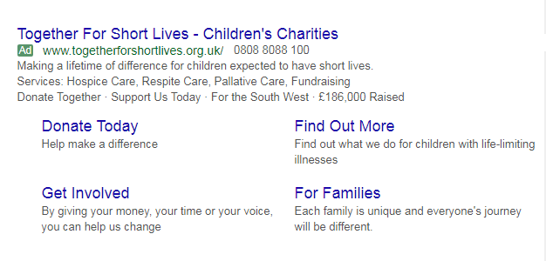
1. Make Use Of All Ad Extensions
Use all ad extensions where you can to improved CTR (and so quality score)
Sitelinks commonly used, but think about structured snippets, call extensions, call out extensions

Slide 15
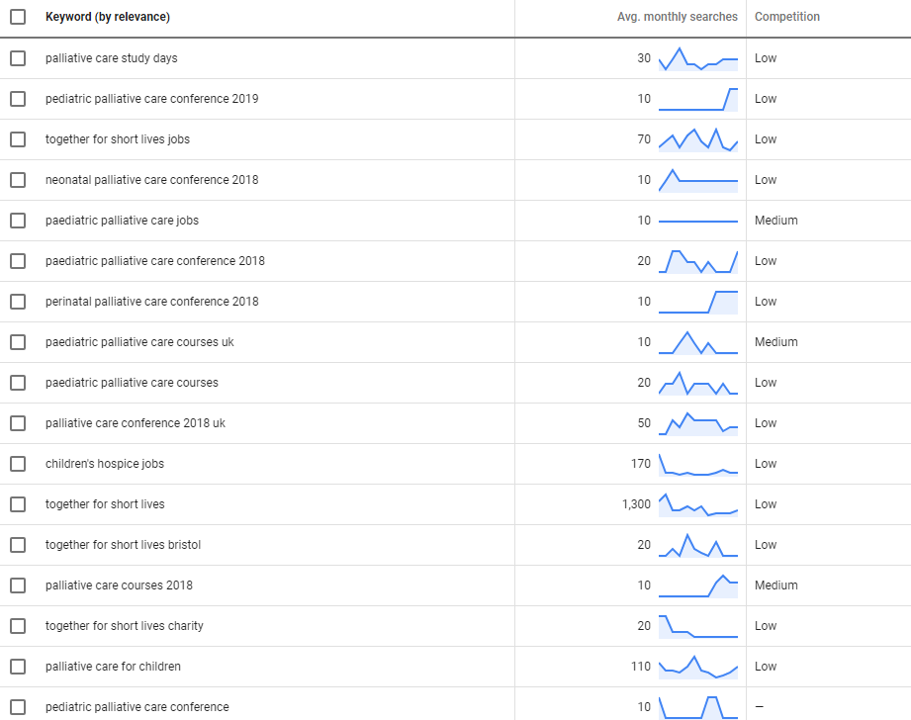
2. Long Tail & Broad Keywords
Use broad match modified terms to drive more traffic
(although keep on top of negatives and relevancy)
Do use long-tailed keywords, this will help with bid caps
Use Google’s Keyword Planner to get new ideas

Slide 16
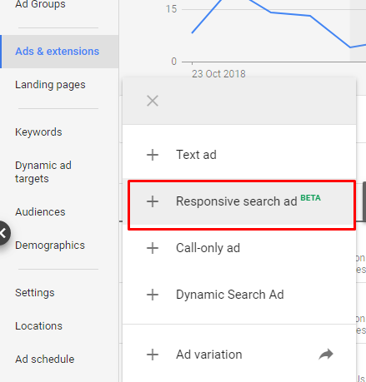
3. Best Practice Ad Copy
For best QS, your ad copy needs to reflect the keywords in that group
If your keywords aren’t themed closely enough, there’s no way an ad can be relevant – split into different ad groups
Reflect your keywords in headline 1 to help with CTR
Use new 3rd headline and 2nd description
Add in some responsive search ads

Slide 17
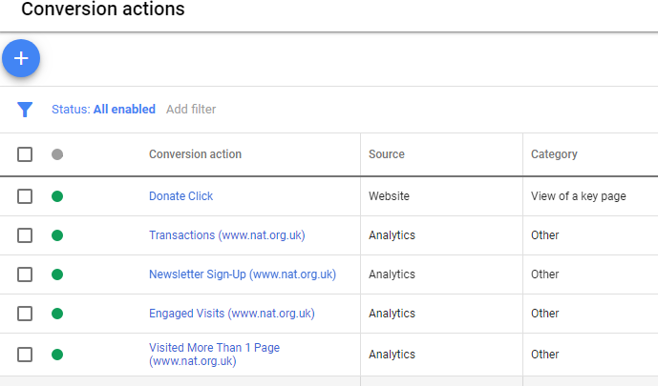
4. Multiple conversions
Import more than one conversion goal, the more the system has the better
Whilst donation is key, bring in engagement metrics too

Slide 18
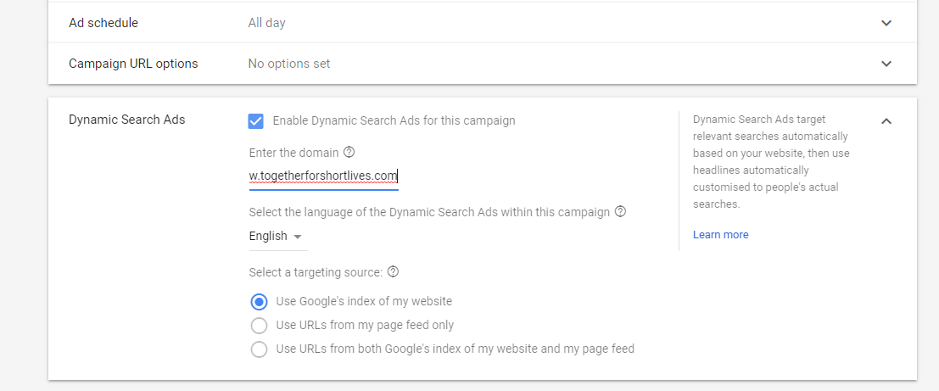






5. Trial a DSA Campaign
Dynamic Search Ads are the easiest way to find customers searching on Google for precisely what you offer. Ideal for advertisers with a well-developed website or a large inventory, Dynamic Search Ads use your website to target your ads and can help fill in the gaps in your keywords-based campaigns
When someone searches on Google with terms closely related to the titles and frequently used phrases on your website, Google Ads will use these titles and phrases to select a landing page and generate a clear, relevant headline for your ad.

Slide 19
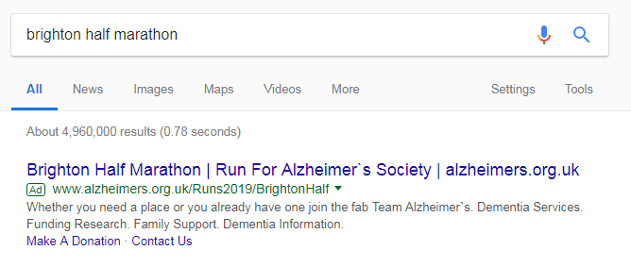
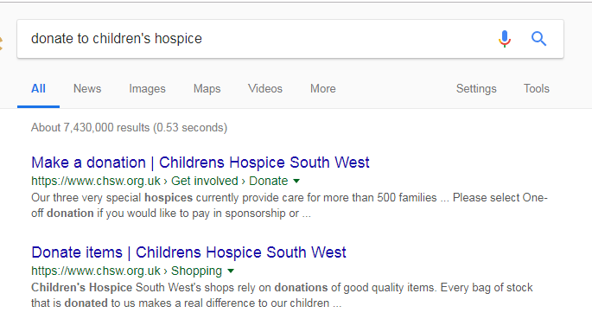
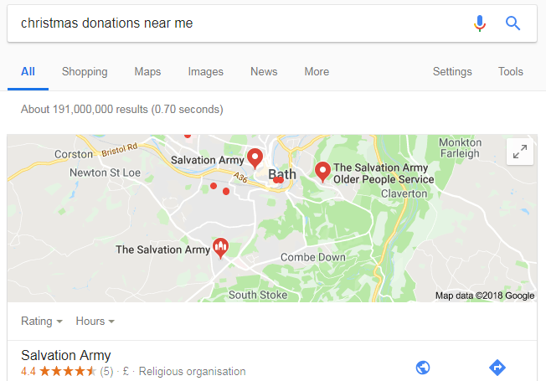
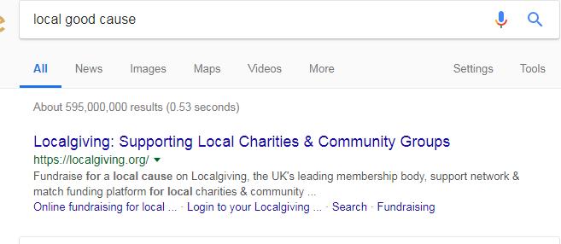
6. Campaign Themes
Keep building out and experimenting with campaign themes
Local running events?
People looking to donate for Christmas?
Respite?
Sibling activities?

Slide 20
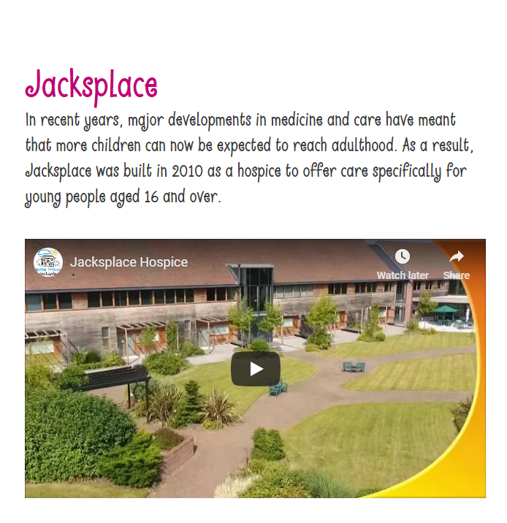
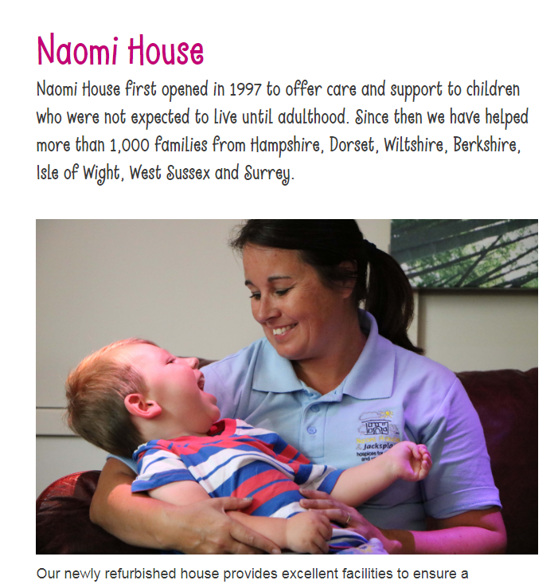
7. Landing Pages
Experiment with sending traffic to more relevant areas of the site over the home page
https://www.naomihouse.org.uk/about-us/naomi-house
https://www.naomihouse.org.uk/about-us/jacksplace

Slide 21
Any Questions?

