Slide 1
'Using collaborative funds and magical thinking to make joint posts successful'
Nicki Fitzmaurice
Head of Nursing
Corporate Nursing
Eva Howes
Patient Experience Administrator

Slide 2

Making the case for change
Palliative Care
Background
Oncology/Haematology team
No recognised specialist service for non- malignant conditions
Inequity of service
Seconded to “make the case”
Method
Data
Patient stories
Hospital/community/hospice stories
Getting their voices heard
OLT/Quality committee/Safety committee/Ethics committee/Clinical Senate/Board/ commissioners/Specialist Commissioners/Conferences/Investment committee

Slide 3
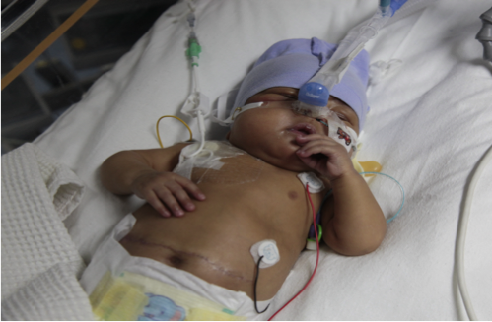
First Steps
Securing my funding
Convincing Trust that investment in Palliative Care Nurses for non-malignant conditions is the right thing to do
Wore them down!
Where did the money come from?
1.4 WTE Band 7 Non-Malignant Specialist Nurses
Prove their worth
CQC coming! Outstanding

Slide 4
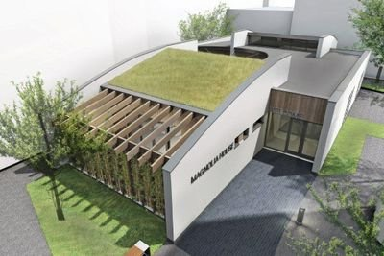
Expanding the Team
Using existing resources to add resilience and learning to the team-Bereavement service/Band 4 liaison post
Use external resources to add additional dimensions to the team. PhD Student studying therapeutic storytelling/art
Work with charities to develop
spaces where we care-Magnolia House /manager
Use charitable grants to provide complimentary
therapies, bereavement groups
Invite bereavement charities to use our spaces
to support families

Slide 5
Expanding the Team
Business Case Joint post with Community Trust
Building relationships with National Charity
OLT/Quality committee/Safety committee/Ethics committee/Clinical Senate/Board/ commissioners/SpecialistCommissioners/Conferences/Investment committee
Withdrawal of support
Everyone agreed we needed Medics.
Molly Olly’s http://mollyollyshop.wpengine.com/

Slide 6
Expanding the Team
Unified the palliative care team
First Medical Post-3 years charity/then picked by commissioners
Relationship with Acorns Hospices
Joint Nursing Post BWCH/Acorns
Joint medical post BWCH/Acorns –out to advert
Plans for trainees

Slide 7
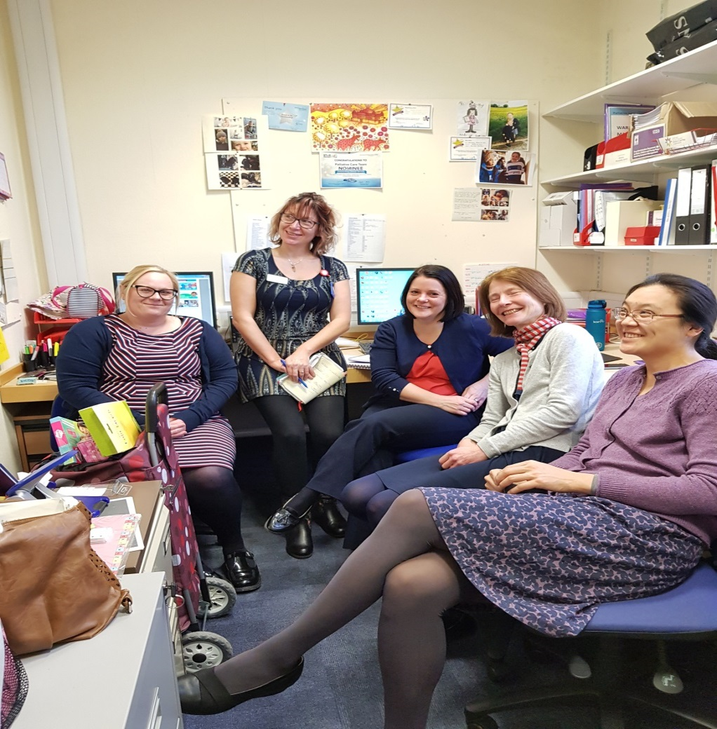


This is what success looks like

