Slide 1
Children’s palliative care nurse rotation posts: a recruitment, retention and resilience solution?
Katie Stevens
Project Manager

Slide 2
Contents
Why and How?
Project so far.
What’s next?
  What do we hope to achieve?

Slide 3
01
Why do we need this project and how have we got here?

Slide 4
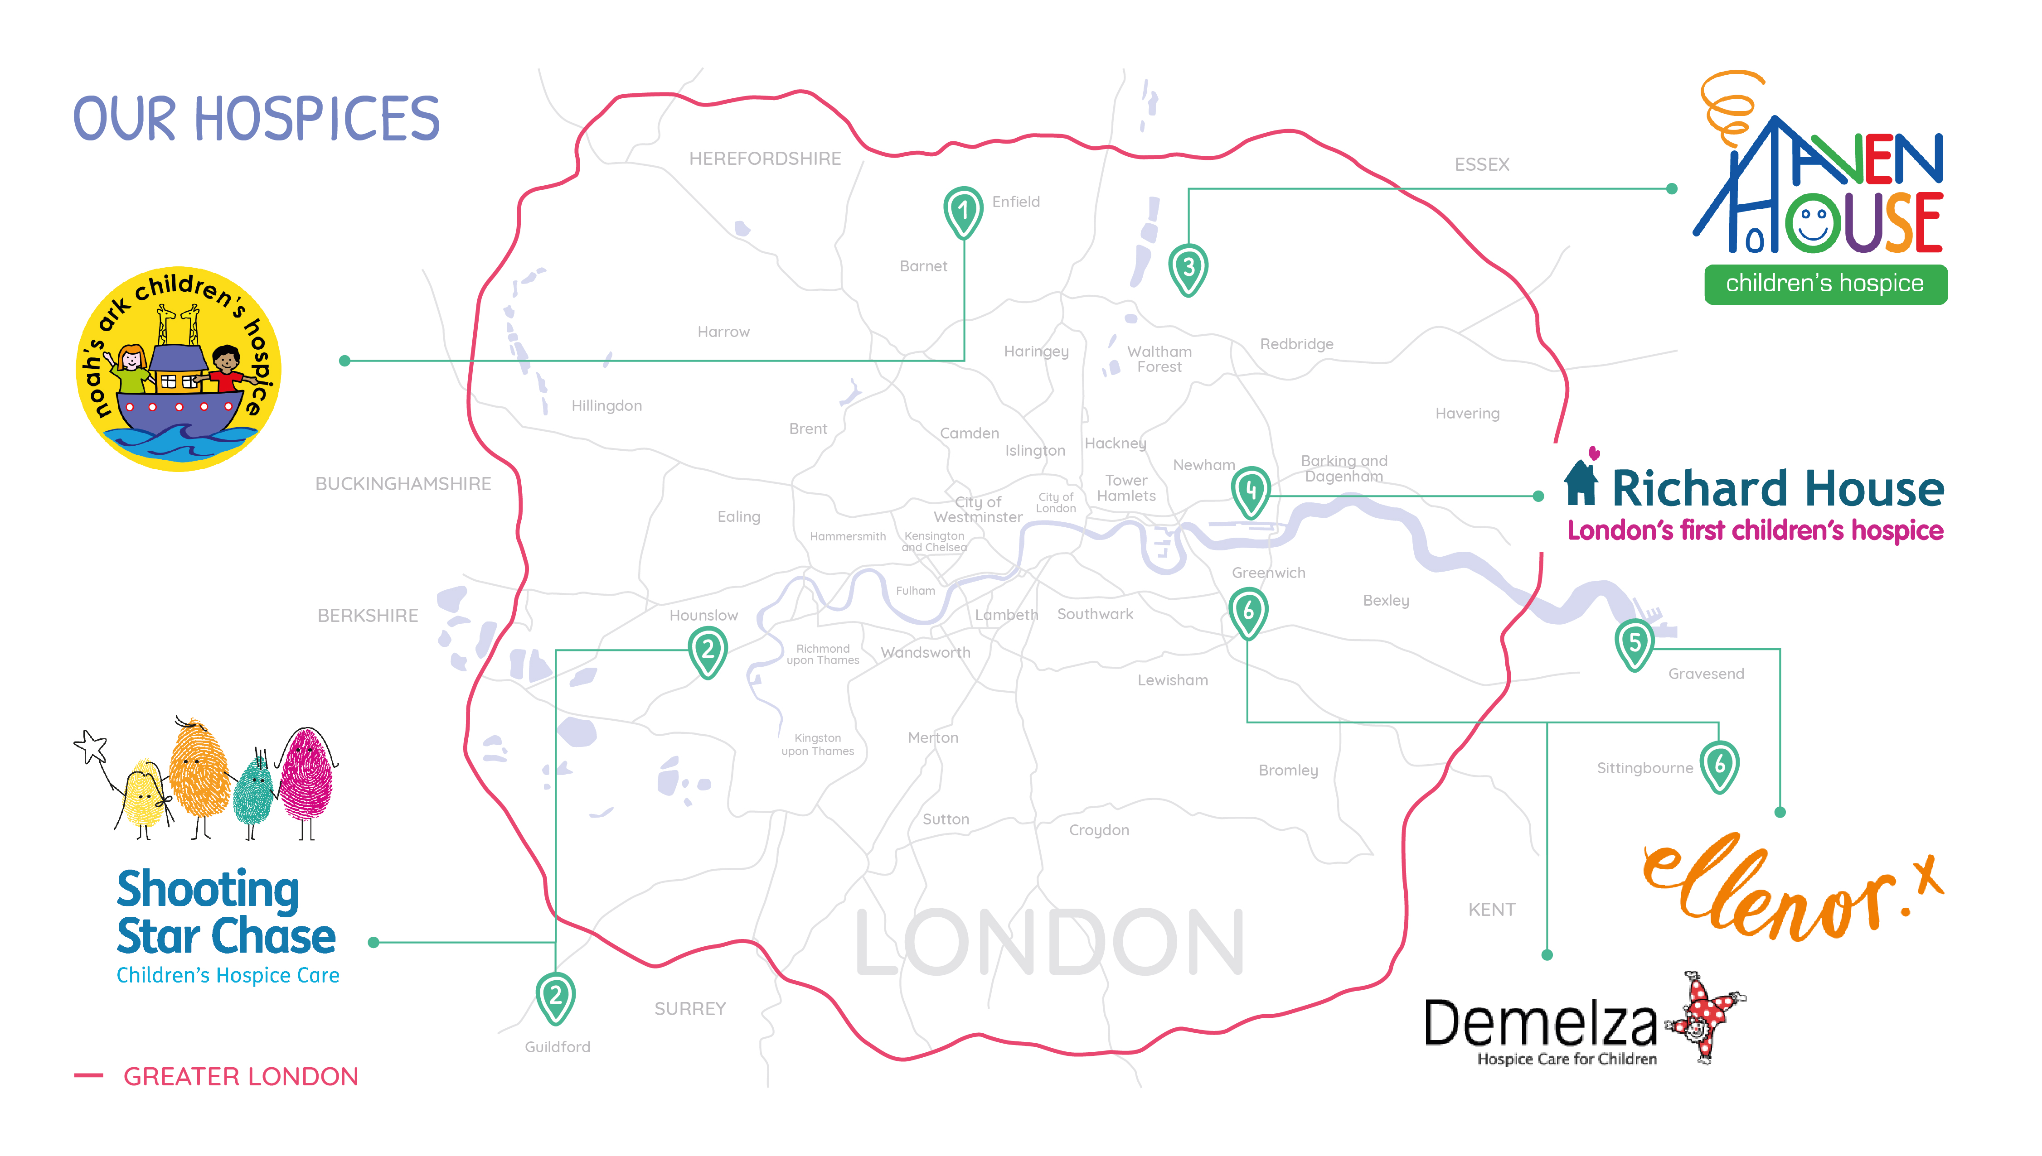
Children’s Hospices across London (CHaL)

Slide 5

Professional context
Why?
More nurses leaving the nursing profession than joining ¹
Fall in numbers applying to study nursing ²
A significant proportion of the children’s hospice and palliative care workforce is due to retire in the next 10-15 years ³
Increased numbers of children requiring palliative care ⁴
Children are living longer with more complex conditions ⁵
Shortage of qualified nurses providing children’s palliative care in the voluntary sector having a negative impact on care ⁵
High demand for children’s nurses across London, leading to strong competition ⁶
Resilience for children’s palliative care nurses can be enhanced with peer support, ongoing training and knowledge transfer ⁷
Nursing and Midwifery Council (2017) New Figures Show an Increase in Numbers of Nurses and Midwives Leaving the Professions. http://www.nmc.org.uk/news/news-and-updates/new-figures-show-an-increase-in-numbers-of-nurses-and-midwives-leaving-the-professions
Stephenson. J. (2018) Nursing course applications have crashed by third in two years https://www.nursingtimes.net/news/education/nursing-course-applications-have-crashed-by-third-in-two-years/7025246.article
Together for Short Lives (2018) A Guide to Children’s Palliative Care https://www.togetherforshortlives.org.uk/wp-content/uploads/2018/03/TfSL-A-Guide-to-Children%E2%80%99s-Palliative-Care-Fourth-Edition-5.pdf
Fraser. L. et al. (2011) Life-limiting and life-threatening conditions in children and young people in the United Kingdom; national and regional prevalence in relation to socioeconomic status and ethnicity https://www.togetherforshortlives.org.uk/wp-content/uploads/2018/01/ExRes-Childrens-Hospices-Ethnicity-Report-Leeds-Uni.pdf
Together for Short Lives (2016) Children’s palliative care nurses needed to bridge care gap https://www.togetherforshortlives.org.uk/childrens-palliative-care-nurses-needed-bridge-care-gap/
Royal College of Nursing (2015) Caring for The Capital: Nursing and the RCN in London file:///C:/Users/Katie%20Stevens/Downloads/Caring-for-the-Capital-Web-Version%20(1).pdf
McConnell and Porter (2017) The experience of providing end of life care at a children’s hospice: a qualitative study BMC Palliative Care 16:15

Slide 6

Burdett Trust for Nursing support
How?
2015
Identified shared challenge
Recruitment
2016
Stakeholder engagement
Successful application to Burdett Trust for Nursing for financial support
2017
Project commenced
Appointment of project manager
Jan 2018 project commences
Retention
Resilience
Impact on care for children and families
Contacted stakeholders across London
Identified aims and objectives

Slide 7
02
Project so far

Slide 8
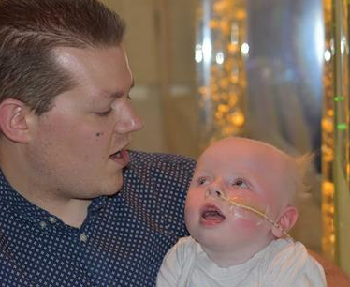


Burdett CHaL Nurse Rotation Project
Project so far
Nurse Survey
CHaL retention and exit interview data
Literature review
University ethics approval for research study
☑ Collaborative networking event
☑ Secondments
☑ Action Learning set with formal leadership programme
☑ Participation in Capital Nurse rotation scheme
☑ Joint working with Capital Nurse IV passport development
Shared post
Children’s palliative care core competency
CHaL clinical skills competency working group

Slide 9
03
What’s next?

Slide 10



Short term..
What’s next?
Feedback
Ideas
Awareness

Slide 11




Mid term..
What’s next?
Numbers
Format
Analysis

Slide 12

Identify, mitigate and overcome challenges
What's next?
Service user involvement
Competing workforce agendas
Changing workforce landscape
Similar work streams
Winter / Summer pressures
Small organisations, small numbers
Timely responses
Differing clinical governance frameworks
Meeting support needs of participants
Remaining responsive

Slide 13
04
What do we hope to achieve?

Slide 14
What do we hope to achieve?
Positively influence recruitment and retention of children’s palliative care nurses across London
Create professional development pathways
Develop a tool to measure resilience and retention
Identify influencing factors for nurses who leave or remain in the children’s palliative care sector
Share findings widely
Create a sustainable, transferable programme
Maximise the benefit to children and families accessing services

Slide 15
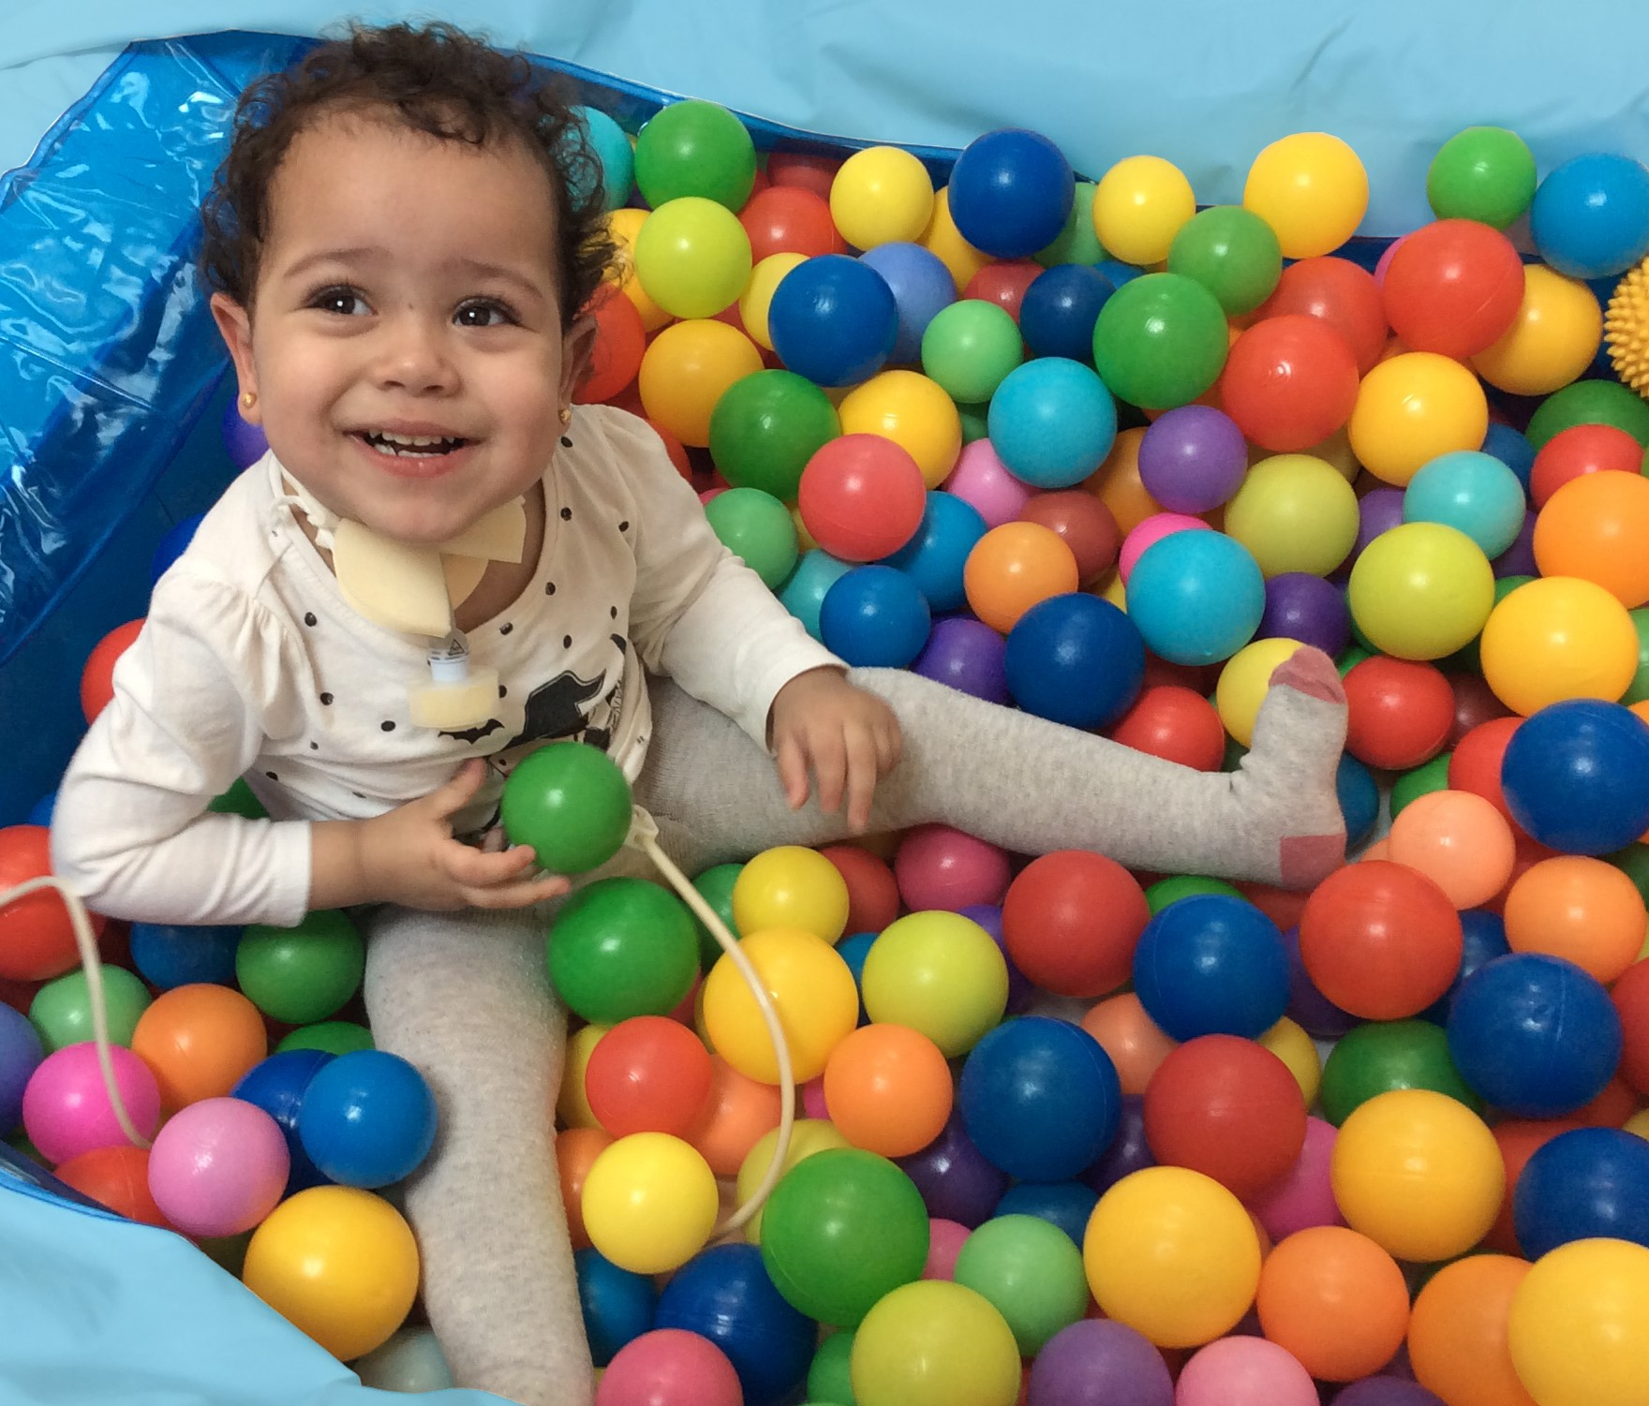
Collaboration + Innovation + Commitment
=
Resilient, Expert, Developed workforce
=
Quality Care and Increased Choice for Children and Families

Slide 16





Contact
Katie
Stevens
katie.stevens@chal.org.uk
www.chal.org.uk
@Katie_J_Stevens
+44 (0) 7722 099037

