Slide 1
Working collaboratively to improve outcomes in community EOL care
Eileen White, Director of Care
Katie Lewis, Specialist Outreach Nurse
Notes:
EW

Slide 2
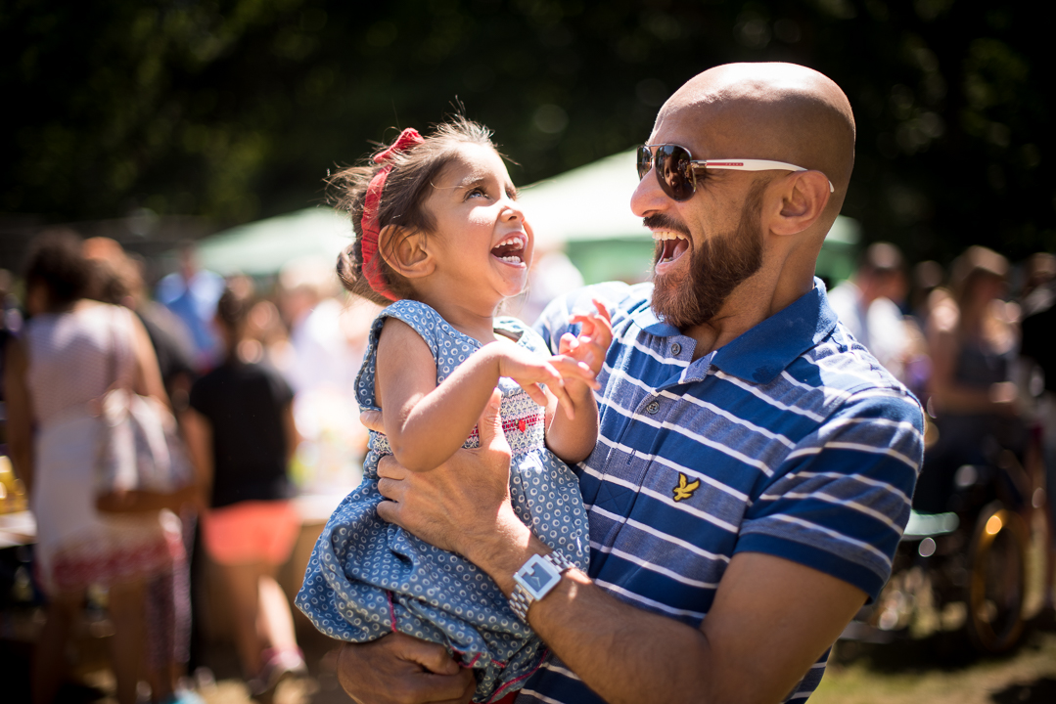
‘Every Child should have access to children's palliative care in the setting of their family's choice and whenever they need it- 24 hours a day, 7 days a week’
Together for Short Lives
Haven House Children's Hospice supports families and cares for children and young people aged from birth to 19 years old with life-limiting and life-threatening conditions across North and East London, West Essex and East Hertfordshire
Notes:
12 boroughs EW

Slide 3
Why Collaborate?
To be able to offer real choice at end of life (NICE 2016)
NHS Long Term Plan
‘NHS England will introduce proactive and personalised care planning for everyone identified as being in their last year of life. A consequence of better quality care will be a reduction in avoidable emergency admissions and more people being able to die in a place they have chosen’ (1.42, page 25)
Local statutory services stretched and very little capacity to support 24/7 end of life in the home
Notes:
EW

Slide 4
Developing our EOL Hospice at Home Service
Pilot for 6 months in one borough
Acceptance of other referrals for EOL care from neighbouring boroughs in this time
Joint working with local specialist children's nursing
Particular targeting of CYP who have cancer by engaging with local POSCU’s and developing specific services e.g. teenage cancer group, outreach play etc
Working with local commissioners and developing pathways
Expansion of the service in line with need
Notes:
KL

Slide 5
Notes:
Statutory funding - EW

Slide 6
Notes:
At any point families can change their mind – EW
Empower them to remain at home
Avoid unnecessary hospital admission
Parallel plan – easy access to inhouse hospice support

Slide 7
Case Study - Amit
16 year old young man
Relapsed Brain Tumour diagnosed at 8 years old
Access to palliative physiotherapy
Teenage Cancer Group
Hospice at Home
Joint MDT work at home to maximise comfort and wellbeing
Notes:
Chemotherapy KL
Radiotherapy
Surgery
H@H when condition deteriorated play coordinators – memory making, birthday gift for his mother
Joint MDT – CCN’s GOSH Palliative Care team, HH Physiotherapy

Slide 8
EOL Care for Amit
Local hospital admission – poor prognosis and rapid disease progression
EOL wish to die at home
Rapid discharge from local hospital on a Friday
Hospice at home visits over weekend (offer of all night nurse)
Joint working with CCNs & GOSH
Symptom management – home physiotherapy
Peaceful death at home on 5 days later
Ongoing bereavement support
Notes:
Spiritual Support KL
Social stimulation
Art and Crafts at Home
Memory work
Teenage Oncology Youth Group
Therapy
Physiotherapy at Home
Practical Support
Pressure relieving mattress
End of Life wishes
24/7 specialist nursing advice and support
Symptom management including nurse prescribing

Slide 9
Case Study - HH
16 year old young man with metabolic condition - end stage heart disease
HH preference to go home
Expected to die within 3 days of discharge
DNR and symptom care plan in place
Not know to CCNT before or hospice
CCNT not able to support 24/7 but could offer 9-5 Mon to Saturday
24/7 cover required as on- call
Availability of a hospice nurse to work in the home if needed to support family caring for HH
Notes:
KL

Slide 10
Collaboration
Joint visit with CCN/CNS where possible
Hospice at home team on call out of hours
Aquatic physiotherapy
Home screening of a film not yet on release to the public
Equipment
Counselling
Peaceful death at home 4 weeks later
Transferred to hospice bereavement suite at family’s request
Notes:
KL

Slide 11
How did this work?
CCNT were lead community professionals
Haven House staff reported back to CCNT each morning re: night calls
CCNT called family daily and/or visited feeding back information to the hospice staff
‘Out of hours’- weekend calls from Haven House to the family
Parents had clear information of who to contact and when
Notes:
KL

Slide 12
What went well?
Early acknowledgement and acceptance of team roles
Early recognition that CCN could not provide 24/7 cover
Good communication between teams
Willingness for team to support each other without question e.g. supplies, equipment etc.
Peer support
Family clear about who to contact
Seamless on going support from hospice post bereavement as family already known
Notes:
KL

Slide 13
Case Study - BH
5year old child with metastatic disease as a result of Wilm’s tumour – lungs affected
CCNT and local CNS knew family well
BH had been referred to the hospice previously as part of cancer support – family felt not needed at the time
Parents very anxious about EOL care- cited hospice as preferred place of death at the ‘very end’
Complex symptom management required
CCNT not able to offer any support out of their working hours and policies did not allow them to support IV infusions.
Notes:
KL

Slide 14
How did this work?
Parental and sibling pre bereavement emotional support
Weekly play sessions inhouse
Hospice at Home available 24/7
Hospice at Home team lead nurses for the ‘technical’ symptom management with support from GOSH palliative team
CNS at local POSCU very supportive – joint home visits
Daily liaison with GOSH and CCNT
Parents clear on who to contact and when
Continual assessment of where parents wanted to be and on- going support required
Virtual Bed
Notes:
Kl

Slide 15
What went well?
Early acknowledgement and acceptance of team roles
Support from local CNS and POSCU team
Early recognition of role CCNT and how they could continue to support
Excellent support from family’s GP
Good communication between teams
Willingness for teams to support each other without question e.g. supplies equipment
Peer support
Family clear about who to contact
Seamless on going support from hospice post bereavement as family already known
Notes:
KL

Slide 16
Challenges/barriers
Lack of understanding of the roles and abilities of hospice staff
Potential for statutory services to disengage if hospice/other services involved
Governance issues in relation to shared working: policies documentation
Defensive attitudes and reluctance to change ? due to feelings of own service being threatened
Identification of key/lead service for the child/young person
Split loyalties for some teams
Notes:
KL

Slide 17
How to overcome barriers
Always keep child/young person and family are at the centre, not the service
Develop a joint commitment for the end goals e.g. pathways support this
Ensure no service is felt to be ‘threatened’- communication and working together to overcome this
Encourage positive working together, not letting barriers such as Governance be an excuse for joint working- provide support for each other
Share case studies where EOL joint working has been successful
Shared learning from previous cases including MDT debrief
Clinical supervision for staff
LCPCN – pilot project North East London on ACPs
Notes:
KL

Slide 18
Impact – Hospice at Home
Notes:
KL

Slide 19
Number of CYP with Cancer

Slide 20
Number of CYP with Cancer

Slide 21
Conclusion
Sharing best practice
Supporting integration of paediatric skills across services
Bespoke quality improvement projects
CCG Transformation Board for CYP
Joined up working CCG/LA
Notes:
EW

