Slide 1
Kent and Medway Managed clinical network
JULY 2019

Slide 2
Kent and Medway MCN
Background
KCC Public Health Observatory findings
MCN Strategy
Next steps
Do & don’ts

Slide 3
PPCT:
Evelina London Children’s Hospital, Guy’s and St Thomas’ NHS Foundation Trust
Great Ormond Street Hospital NHS Foundation Trust
Royal Marsden Hospital NHS Foundation Trust
(Cancer is now the biggest cause of premature death among CYP 5-14 years)
Neonates:
Medway Maritime Hospital Level 3
Ashford Level 2
Margate Level 2

Slide 4
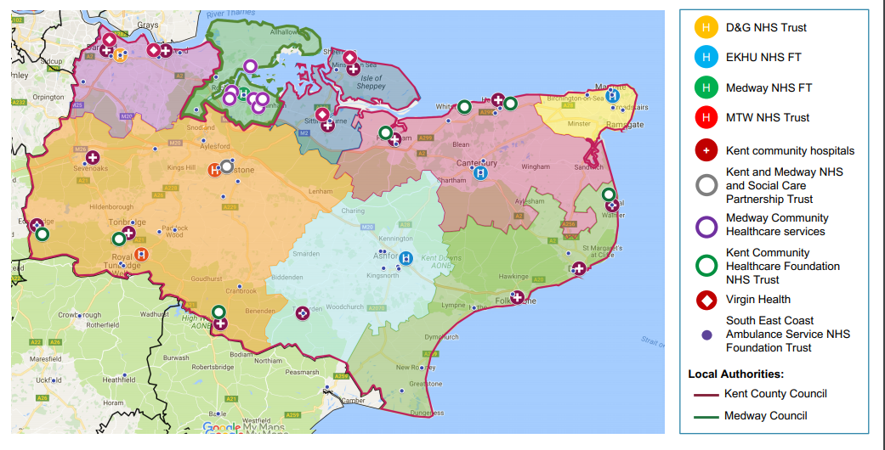
KENT & MEDWAY
Notes:
www.togetherforshortlives.org.uk/commissioning2017
The NICE ‘End of life care for infants, children and young people with life-limiting conditions: planning and management’ guidance recommends that a multidisciplinary specialist paediatric palliative care team should include, at a minimum:
a paediatric palliative care consultant
a nurse with expertise in paediatric palliative care
a pharmacist with expertise in specialist paediatric palliative care
experts in child and family support who have experience in end of life care (for example in providing social, practical, emotional, psychological and spiritual support)
We asked each CCG whether they commissioned services that could provide this. We found that currently just 29% of CCGs are able to offer this, while only 22% can provide this out of hours.
NICE (2016). End of life care for infants, children and young people with life-limiting conditions: planning and management. P31. Available at: http://bit.ly/2g9nIWA

Slide 5
Kent Integrated Data Set
Cohort 1: living CYP with a LLC- 1415
C&YP coded with a LLC during a hospital admission in Kent and Medway from April 6th 2014 to March 31st 2018 and who were alive as of March 31st 2018.
0-3-month-olds excluded
Cohort 2: deceased CYP with a LLC- 279
C&YP who died between January 1st 2006 and December 31st 2017 and had a LLC as a cause of death or contributing factor on the death certificate.
Primary Care Mortality Dataset
Kent residents only

Slide 6
Living Cohort
Overall trend:
580
426

Slide 7
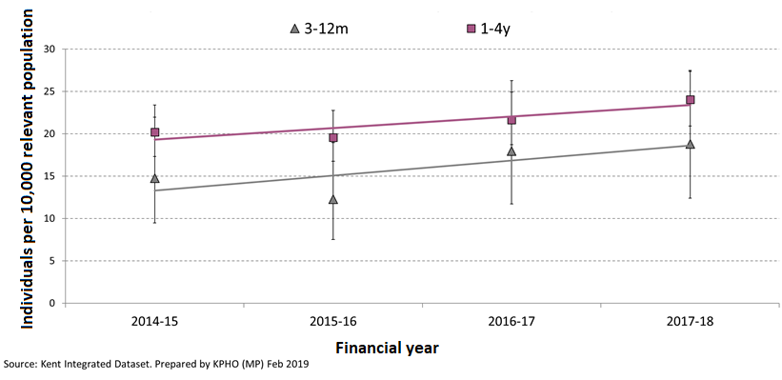
Living Cohort
Prevalence by age

Slide 8
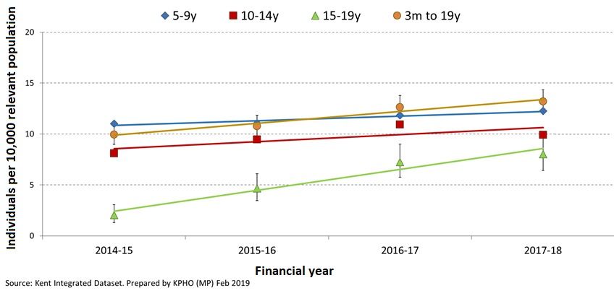
Living Cohort
Prevalence by age

Slide 9
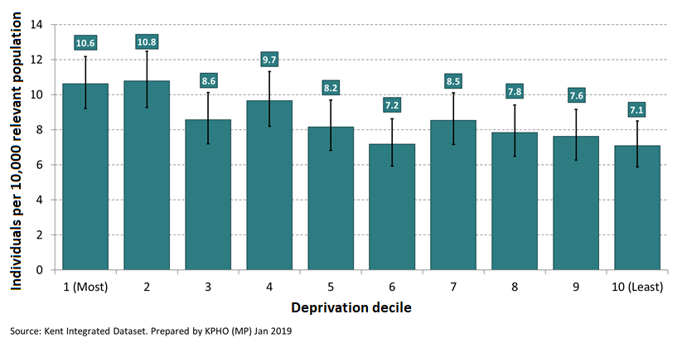
Living Cohort
Prevalence by deprivation

Slide 10
Deceased Cohort
Overall trend
89
59

Slide 11
Deceased Cohort
Location of death:

Slide 12
Recommendations
Service activity data:
Patient and family engagement
Use KID for cohort 2 data to link unplanned admission rates and hospital deaths
CDOP data showing deaths by preferred place of death (new National Child Mortality Database April 2019)
Include neonates to reflect the wider system
Look at prevalence by ethnicity
Engage Acute NHS Trusts
Prevalence in males

Slide 13
Next Steps
Seek co-production with CYP & families
Agree core objectives
Agree accountabilities
Align MCN strategy to NHS Long Term Plan
Seek route to Integrated Care System sign off (mandate)

Slide 14
TIPs
Seek representation from Commissioners & Providers + co-opt in
Seek co-production with CYP & families from the outset
Develop a Executive Group - strategic steer & decision makers
Develop a Clinical Reference Group – get stuff done!
Seek specialist paediatric palliative care team support (sessions)
Refer to reliable data (National Child Mortality Database April 2019)
Align to NHS Long Term Plan
Seek routes to achieving sign-off via Integrated Care Systems
Above all, be patient!

